Slide 1
Midterm Progress Report
Client: Chet Udell
Project: Evaporometer
Team 53: Alessandro Lim | Jaydeep Rotithor | Touku Cha

Slide 2
Introduction: Evaporometer
The purpose of the project is to develop an open-source and automated data gathering systems
The cost should be affordable and easily replicated
3 Parts:
Receiver (Touku)
Transmitter (Alessandro)
Geovisualization (Jaydeep)

Slide 3
Current Situation
Working on Transmitter
State Diagrams of the code
Documentation and Schematics
Ported from TSL2591 Sensor to the TSL2561 sensor
The transmitter can now read temperature, humidity, infrared intensity, lux intensity, and rainfall level.
The transmitter can also send the data to the receiver.
Code is ready on the live demo on the 5th of March

Slide 4
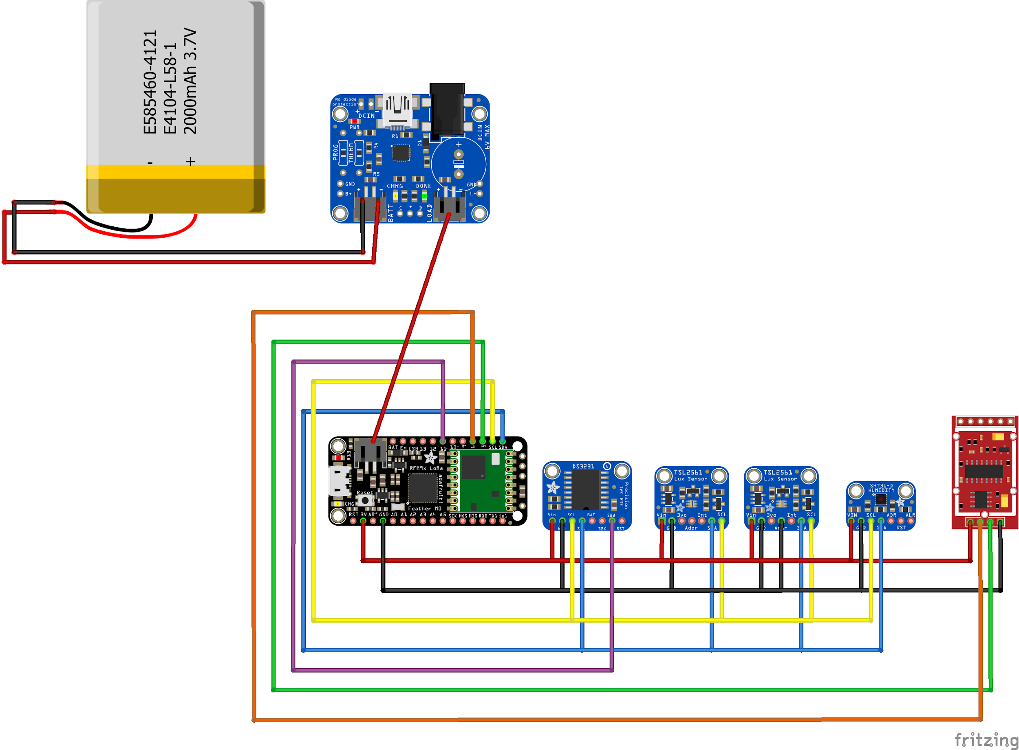
Transmitter Wiring

Slide 5
Work Left
Assembling the transmitter (Next week)
Calibrating weight sensor (Next week)
Another open-sensing team member working on this
Measuring Albedo
Code is almost done
Casing not done, but can be tested on breadboard
Reset Button (Not yet confirmed by client)
SD card reader on transmitter (Not yet confirmed by client)

Slide 6
Problems Faced
Was not making much progress from week 1 to 4
Only worked on documents that the open-sensing team requested
Was unsure what I was supposed to work on.s
Progress is quickly picking up now.

Slide 7
Live Demo

Slide 8
Current Standing
Receiver
PushingBox
Google Spreadsheet

Slide 9
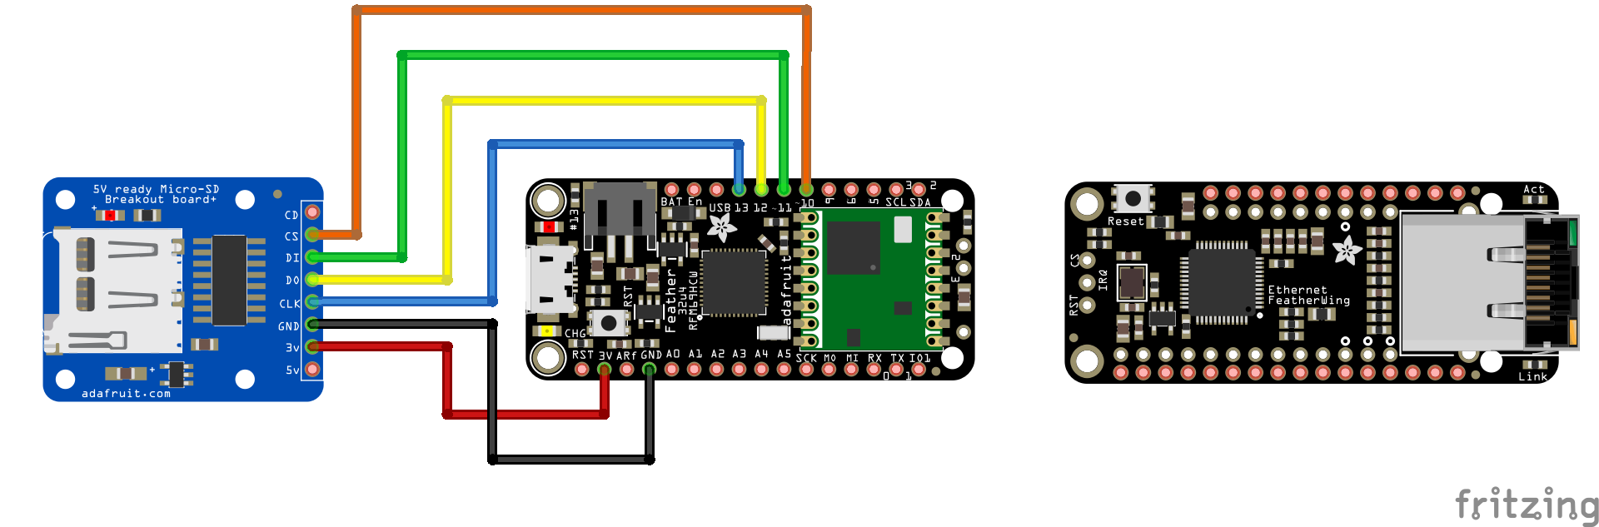
Receiver

Slide 10
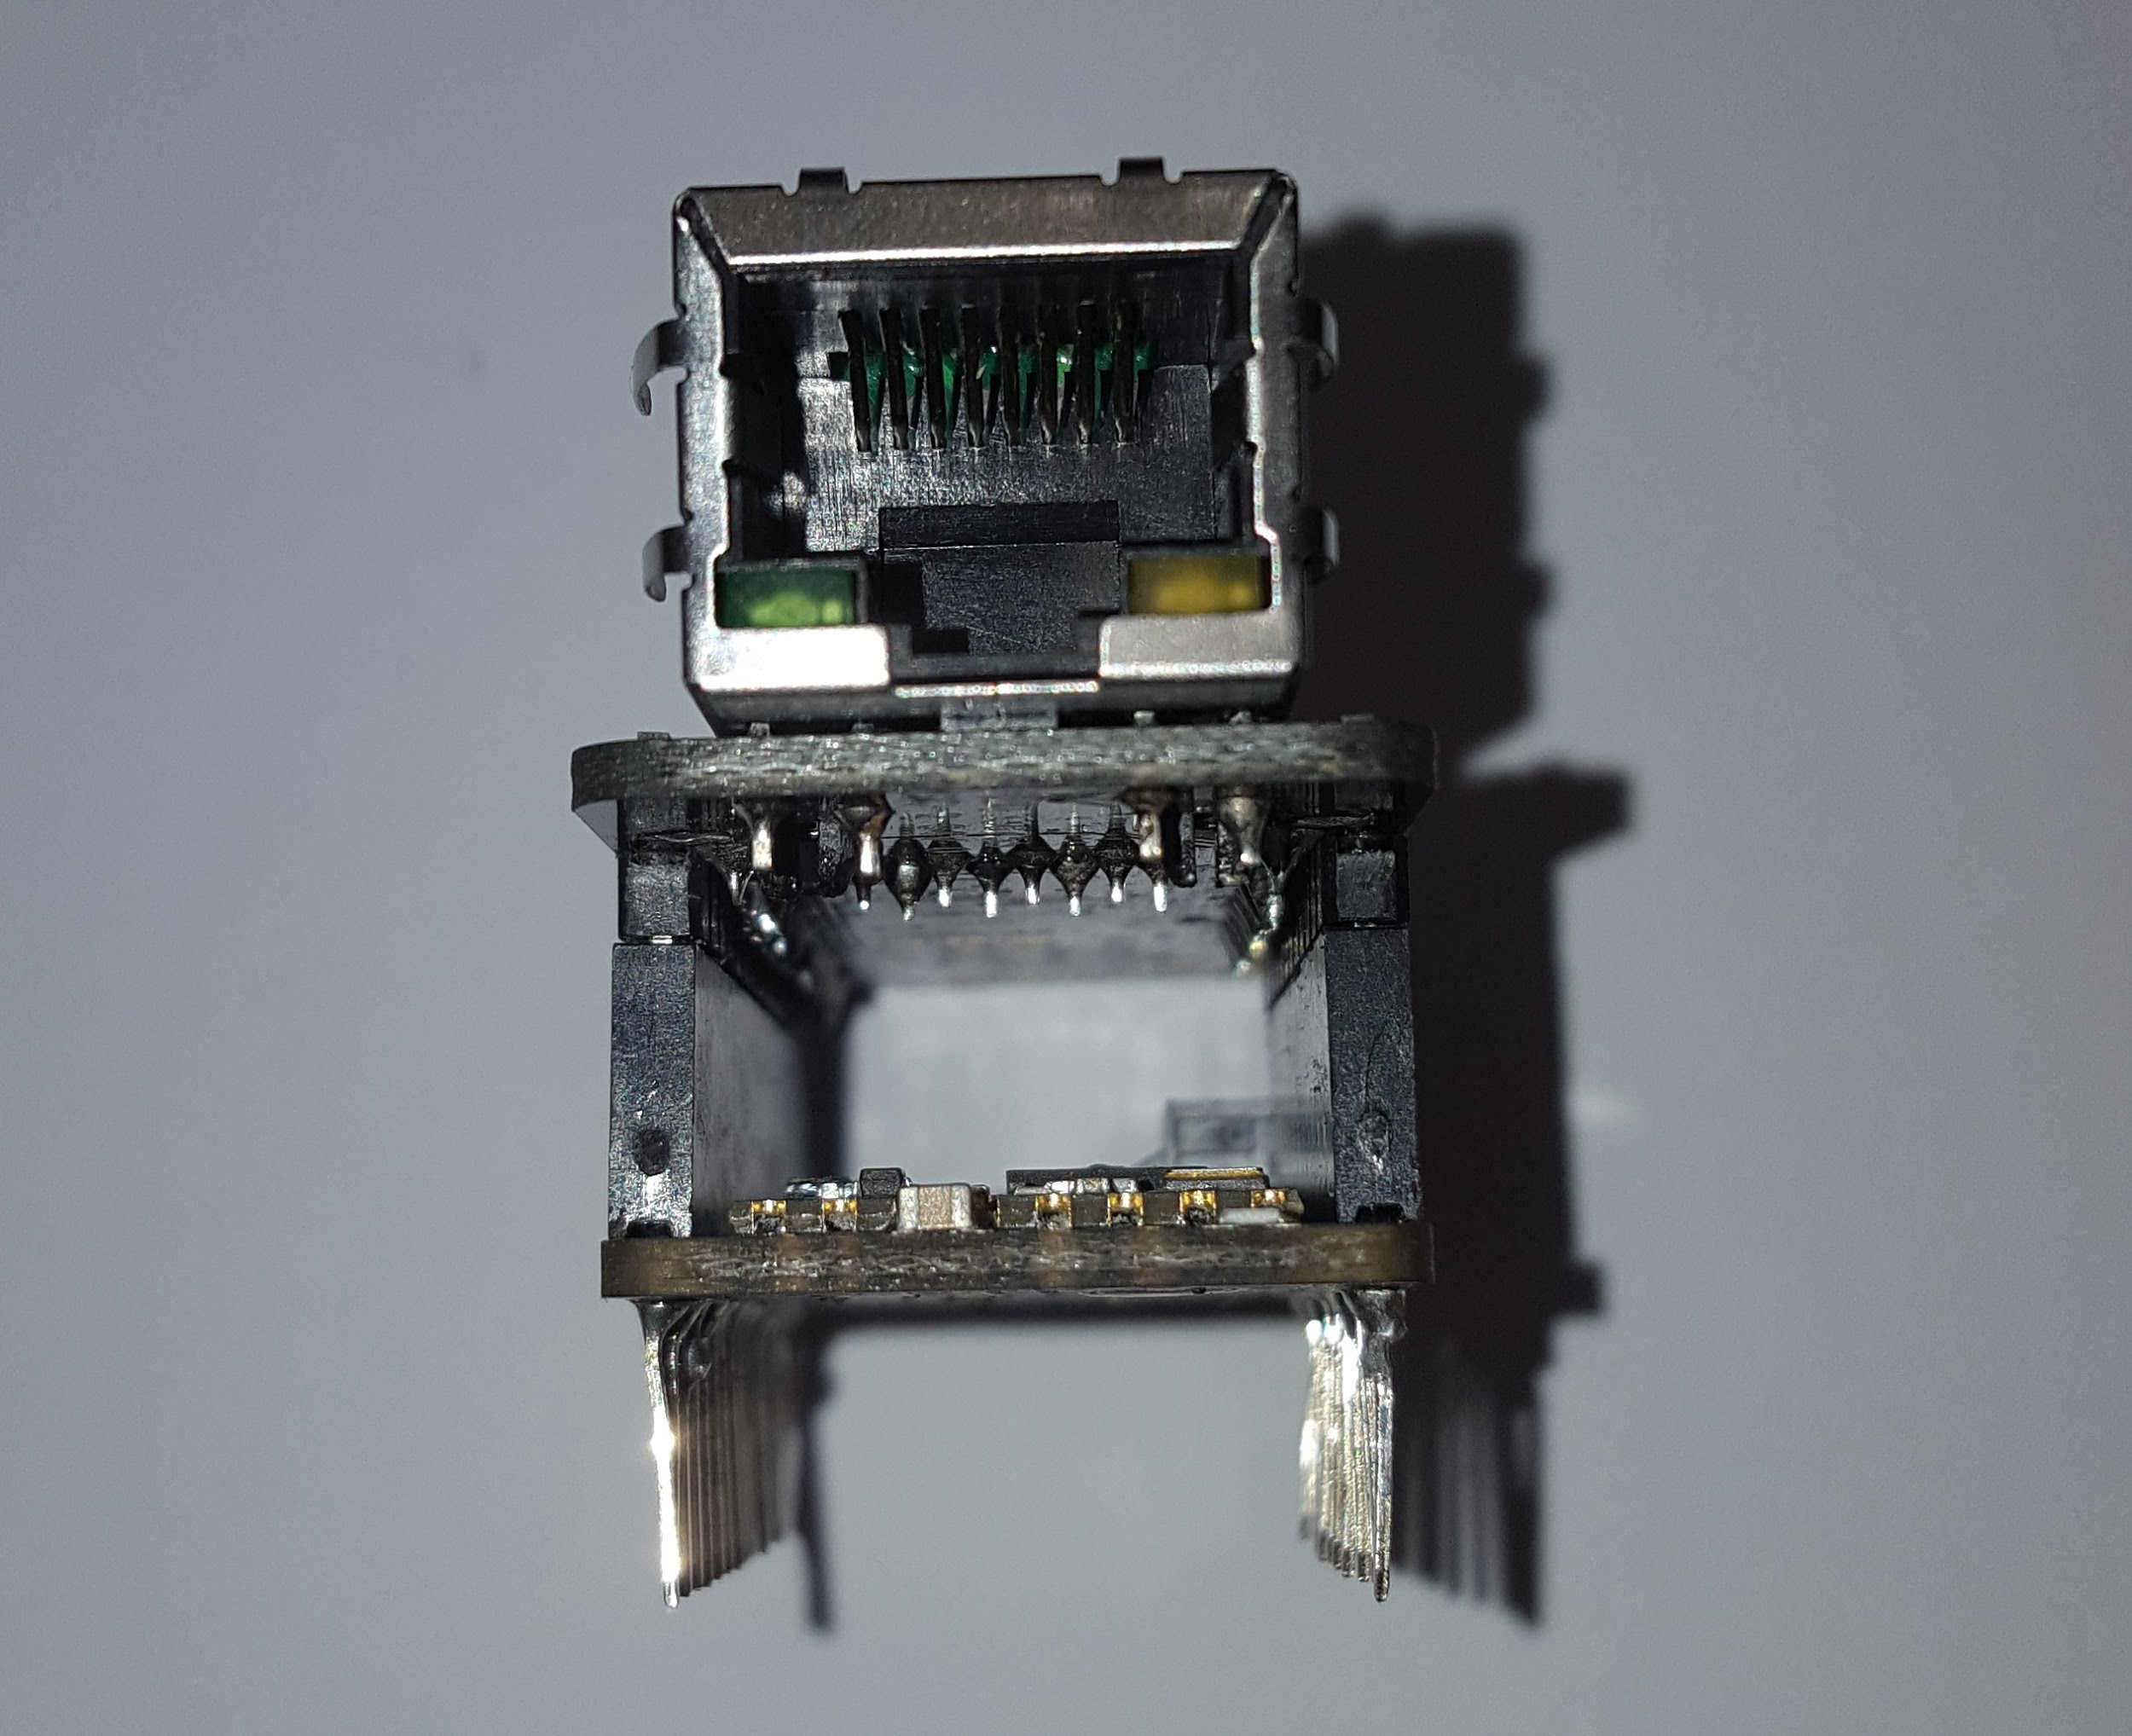

Slide 11
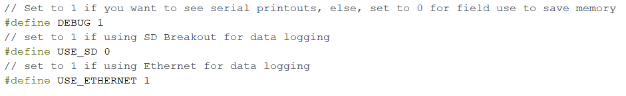
Receiver Code Setup

Slide 12
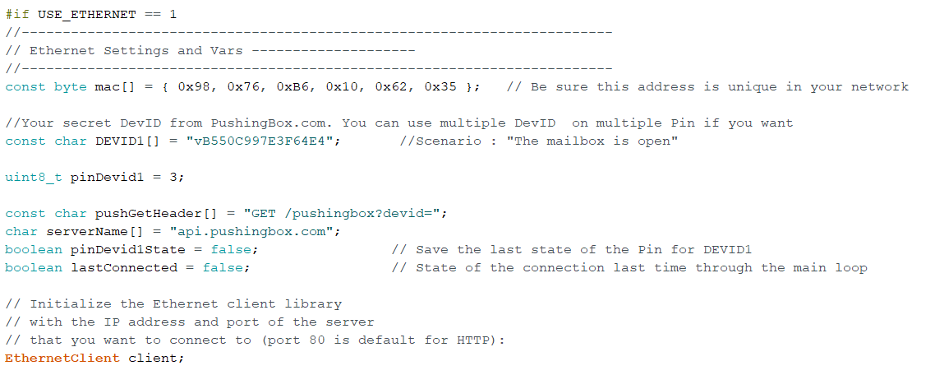
Receiver Ethernet and PushingBox

Slide 13
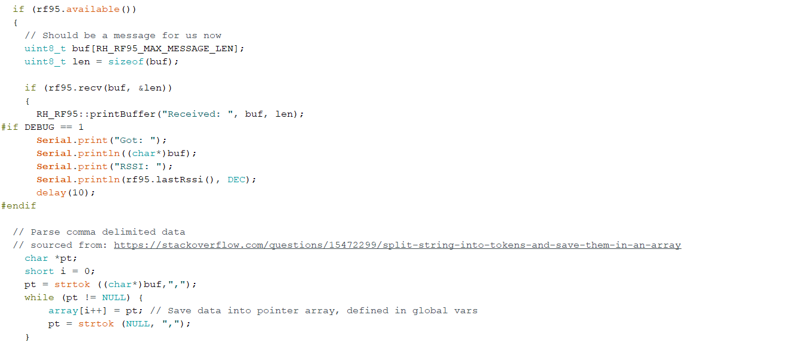
Receiving Data

Slide 14
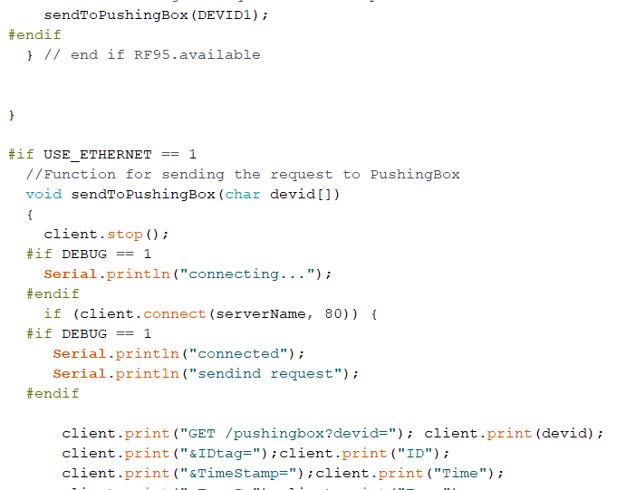
Transmitting to PushingBox

Slide 15
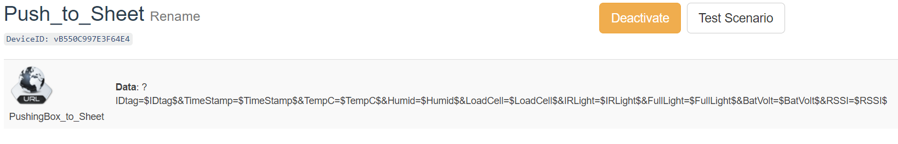
PushingBox Scenario

Slide 16
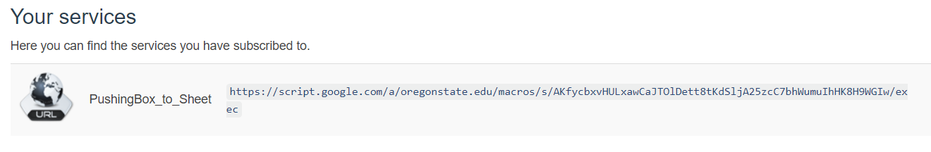
PushingBox Services

Slide 17
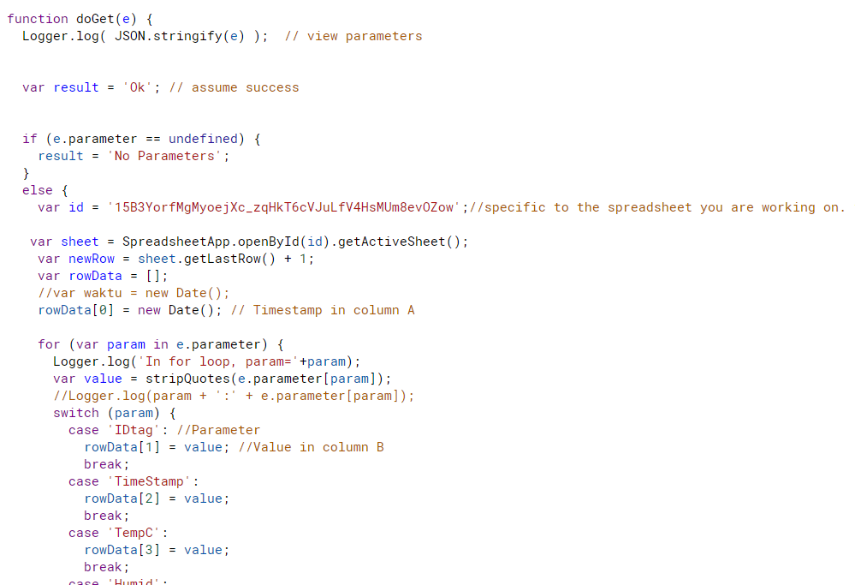
Google Script

Slide 18
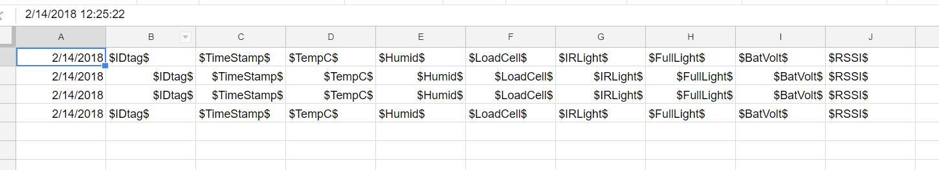
Google Spreadsheet

Slide 19
Demonstration

Slide 20
Work Left
Uploading data
SD Card
Open house demo

Slide 21
Geovisualization- Current Status
Currently have the website running. The general layout of the map has been set up.
I have a base map and charts that can accept data.
I have a table set up at the bottom of the webpage.
I have a socket connection between the client file and the server file. Through this connection, I can push data to the webpage

Slide 22
Geovisualization- Work Left
I need to finish the charts so that they can accept the live data.
I need to add geographic data to the incoming data stream so that it can appropriately be plotted on the map.
I need to create a middleman software to convert data from Google Spreadsheets to MongoDB.
I need to change the server so that it can accept live data from MongoDB instead of static data from a file.
I need to separate the incoming data based on its type. For example, humidity data should be separate from temperature, temperature should be separate from rainfall, etc.

Slide 23
Geovisualization- Problems faced
Most significant roadblock involved choosing whether to send data to Google Spreadsheets or straight to MongoDB.
Went back and forth on this for a while before settling on staying with Google Spreadsheets.
Despite the advantages of MongoDB, it would require significantly fewer developer hours to use Google Spreadsheet and create a converter to send data to MongoDB.
Other minor roadblock involved getting socket.io to work.
Struggled with trying to send messages for a while, did not understand how the connection between server and client worked with socket.io.
Eventually figured it out after looking at API.

Slide 24
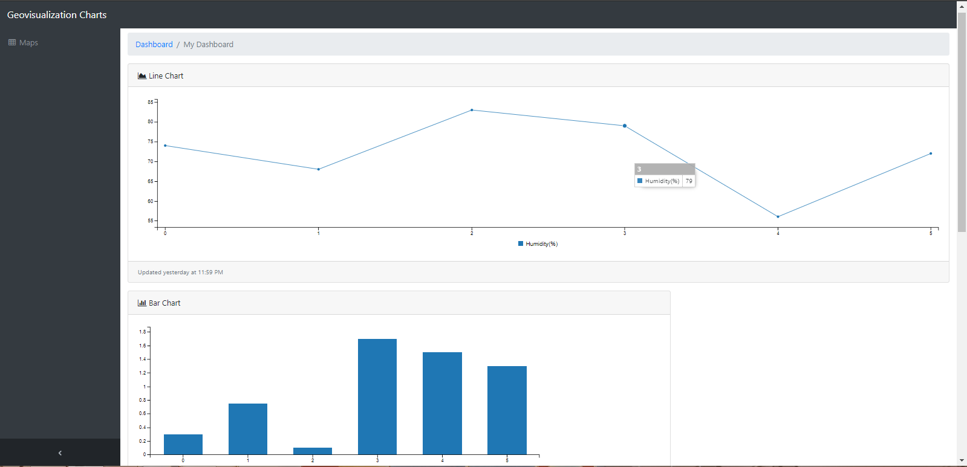
Geovisualization Charts

Slide 25
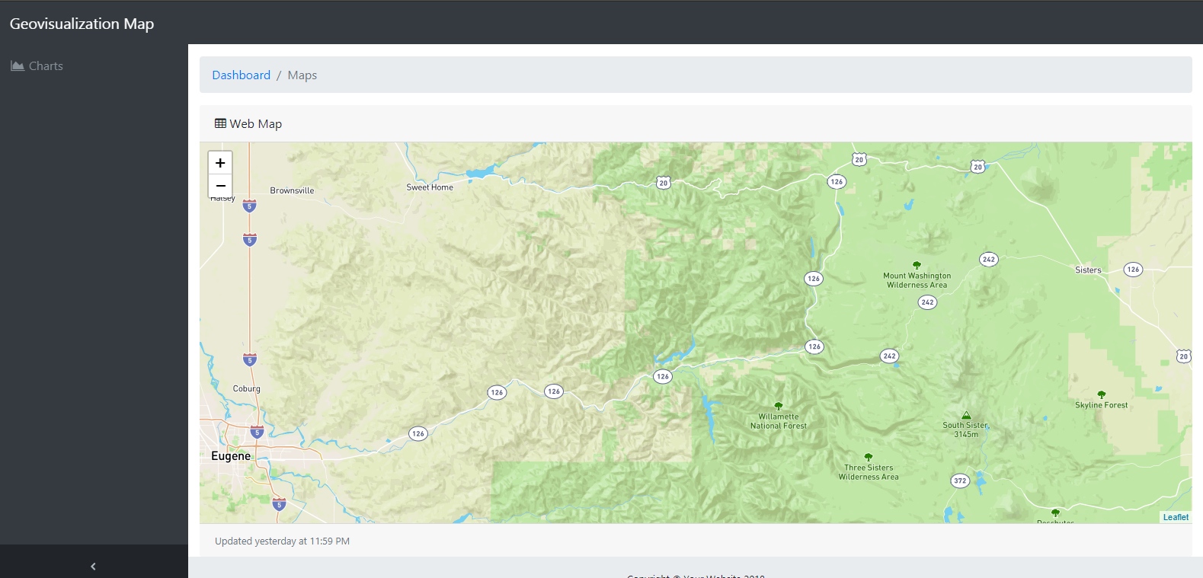
Geovisualization Map

Slide 26
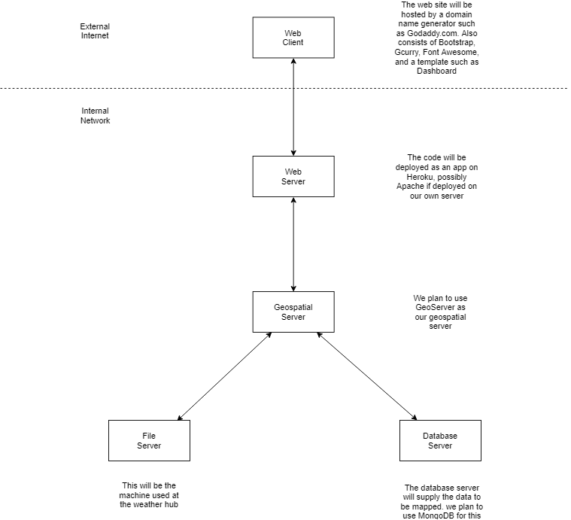
Geovisualization State Diagram

